Slide 1

Soccer Analytics: Predictive Modelling For Performance and Outcome
Team 3
NAMITA
JASON
YING FENG
AYUSH
YU TING

Slide 2

TABLE OF CONTENTS
01
Business Opportunity
02
Data Sources and Preparation
03
Data Exploration
04
Predictive Analysis: Player Rating
05
Predictive Analysis: Match Outcome
06
Dashboard
07
Limitations and Conclusion
Analysis of the Issue
Proposed Business Solution
Introduction to datasets
Data Cleaning
Data Exploration on Match and Player dataset
Models used for Analysis
Comparison and Overview of Results
Models used for Analysis
Comparison and Overview of Results
Live Visualisation with PowerBI

Slide 3


Slide 4
01
Business
Opportunity

Slide 5



The Problem: Inflated Market & Spending Gap
Ayush
“As such, I don’t foresee the market deflating anytime soon. [...] A relatively small number of clubs will grow and proper, whereas the majority will struggle to keep up and will be unable to sustain significant long-term expenditure on players.”
- Prof Simon Chadwick, University of Salford
“What deals like this do is push up the values elsewhere in the market. A player who would have previously commanded a fee in the region of 30-40 million suddenly becomes a 60, 70 or 80 million player.”
- Saif Rubie, Soccer Agent
Sources: JakartaGlobal & Bleacher Report

Slide 6


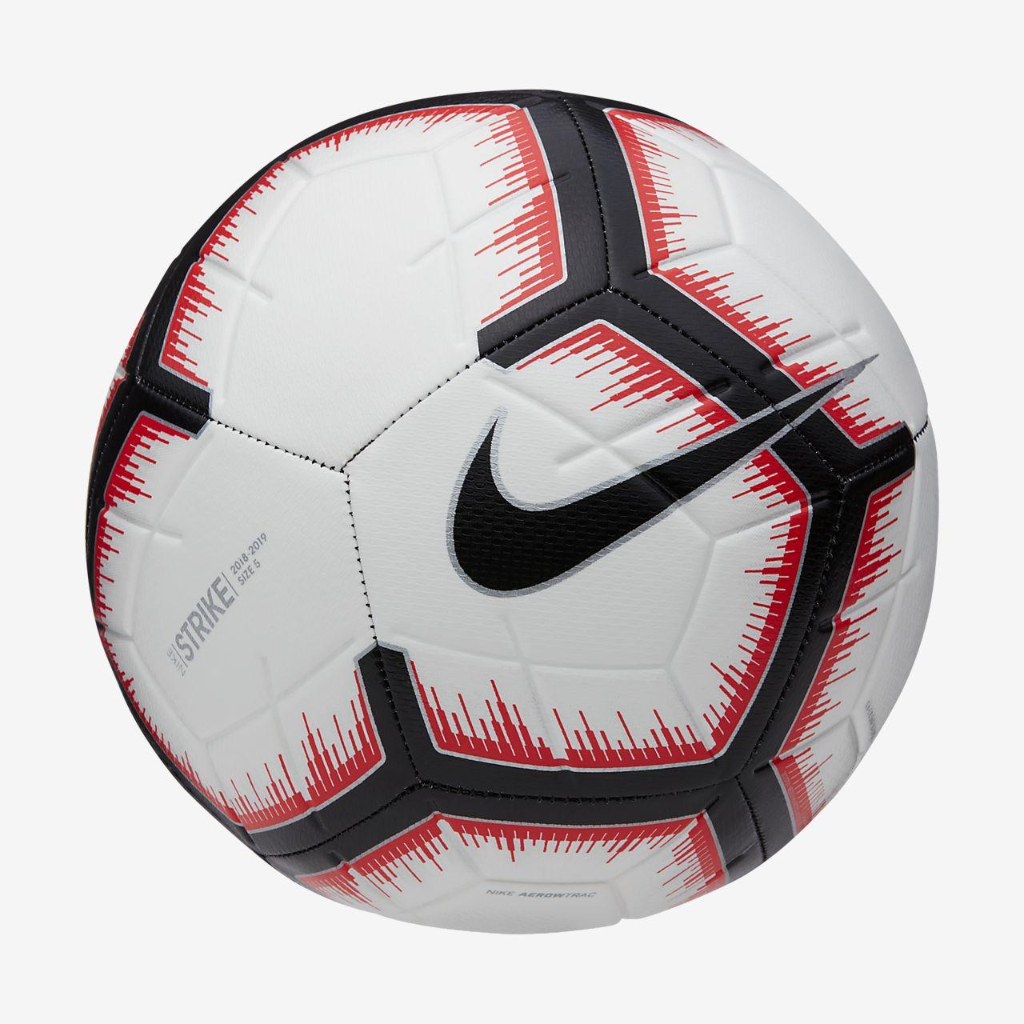
The Analytics Gap
Ayush
Dynamism: Multitude of factors affecting the game at any given time
Free-flowing: Football is ‘fluid’, as opposed to baseball and cricket, which are a series of individual events on end
Predicted Germany to be finalists; they did not make it past the group stage
Changed 50% of their predictions before the knockout stages commenced
Sources: Surukumar, Sunil S (2019). “Moneyball or Moneyfall? Current State of Analytics in Soccer and What Future Holds”

Slide 7



Proposed Analytics Solutions
Ayush
Player rating prediction:
Identifying attributes that make up a high performing player
Match outcome prediction:
Know what factors influence the match result, and by how much
Dashboard:
At a glance squad updates for managers and scouts

Slide 8


3-Pronged Applicability
Ayush
Training → Matchday preparation by knowing the factors influencing match outcome
Recruitment → Scouting and signing undervalued talent with desired attributes of high-performing players
Dashboard → To visualise teams’ attributes, tactics and player info conveniently
Since smaller clubs cannot afford to pay premiums on players, coaches, and facilities, they can leverage on analytics to improve processes via key actionable insights

Slide 9
02
Data Sources
and Preparation

Slide 10

Dataset
Country
League
Match
Player
Player Attributes
Team
Team Attributes
Ayush

Slide 11
Data Cleaning
Match
Player Attributes
Ayush
Derived Columns
Missing Data
Merging
Multicollinearity
Form statistics
Formations
Team overall rating
Removed rows with NA values
19.5k rows remain after removal
Added some columns of team_atttibutes
Gives an indication of team’s match tactics
Betting odds for win, loss, draw were given
Used only prob. of winnings
Age
Removed rows with all columns NA
10.5k rows remain after removal
Merged with player
Gives height, weight, age information
Player overall rating and potential were given
Removed potential rating

Slide 12
03
Data
Exploration

Slide 13
Match dataset
Categorical Y ‘label’: Win/Defeat/Draw
Namita
Goals Difference
Games Won
Games Against Won
Team Overall Rating
Probability of winning for the Home Team
Team Formation
League
Build-up Play Speed Class
Balanced/Fast/Slow
Chance Creation Passing Class
Normal/Risky/Safe
Defence Defender Line Class
Cover/Offside Trap

Slide 14
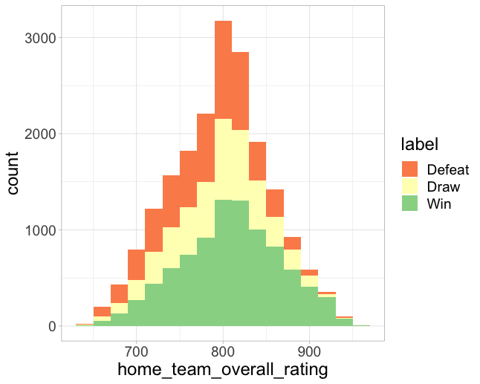
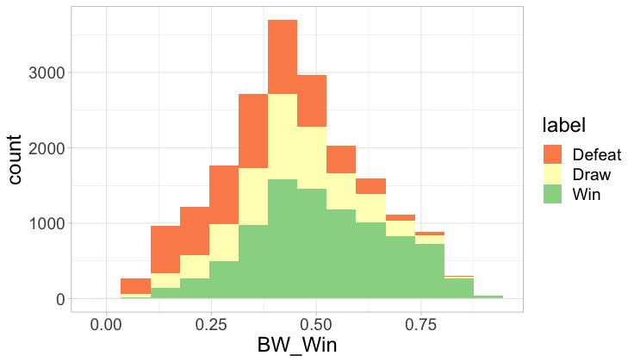
Match dataset
Namita
Histogram of each variable is plotted, grouped by outcome ‘label’
Home team rating & Betting probability:
Proportion of ‘Win’ increases with higher home team rating and higher betting prob

Slide 15
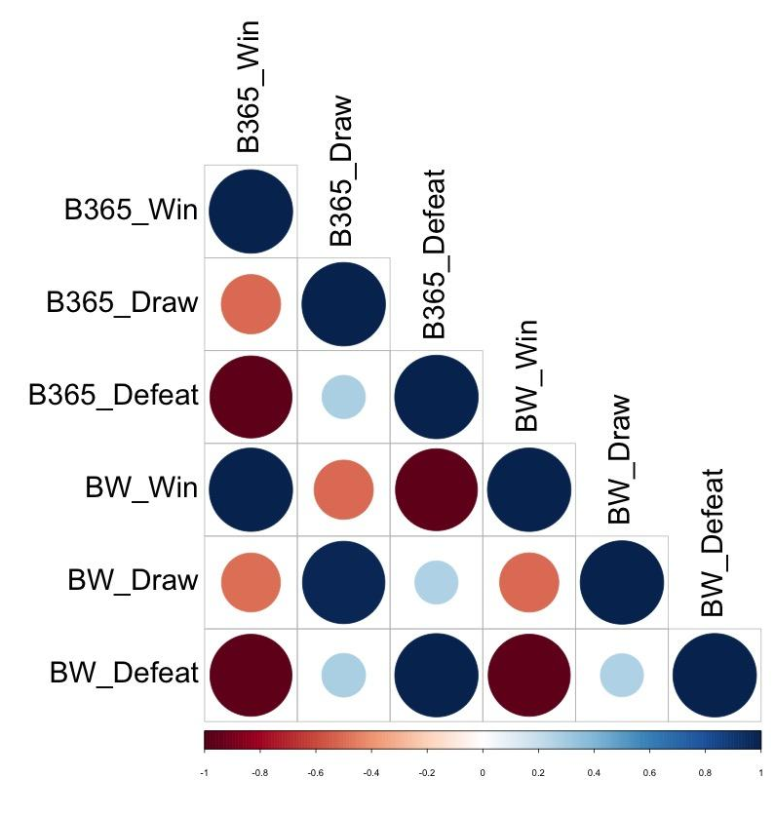
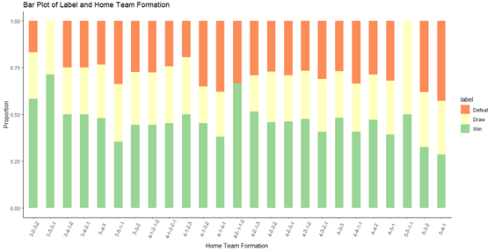
Match dataset
Namita
3-3-3-2
3-3-3-1
4-2-1-1-2
Team Formation
Formations 3-3-3-1, 4-2-1-1-2 and 3-2-3-2 have the highest proportion of ‘Win’ outcomes but are not commonly used
Correlation plot
Betting probs have high correlation, indicating multicollinearity
→ BW_Win is chosen to represent betting prob

Slide 16
Player dataset
Continuous Y ‘overall rating’: 0 to 100
Namita
Playing abilities
Crossing, finishing, heading accuracy, short passing, volley, dribbling
Player qualities
Reactions, balance, shot power, vision, free kick accuracy, ball control
Height, weight, age
Preferred foot
Goalkeeper qualities
Diving, handling, reflexes, positioning

Slide 17
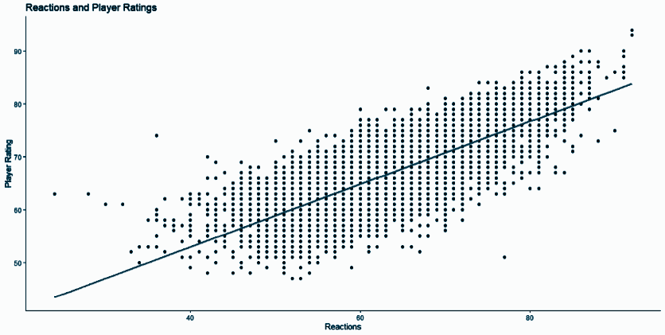

Player dataset
Namita
Correlation analysis of variables against the outcome variable ‘overall_rating’
Potential is highly correlated → multicollinearity issues
Most correlated variables are reactions (0.71), short_passing (0.41) and vision (0.41)
Bivariate analysis of ‘reactions’ shows a clear linear relationship

Slide 18
04
Predictive
Analysis:
Player Rating

Slide 19
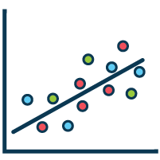
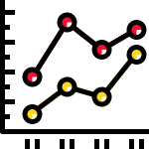



Predictive Models
LINEAR REGRESSION
MULTIVARIATE ADAPTIVE REGRESSION SPLINES (MARS)
CLASSIFICATION AND REGRESSION TREE (CART)
RANDOM FOREST
Namita

Slide 20
Linear Regression
Namita
Feature selection
Train-test split
Obtain model from train set
Apply model on test set
Backward elimination
Manual filtering
Dataset split into 70-30 to be used as train and test set
Manual filtering to ensure statistical significance
Variable importance from model
Calculate Root Mean Squared Error (RMSE) as an indicator of accuracy

Slide 21
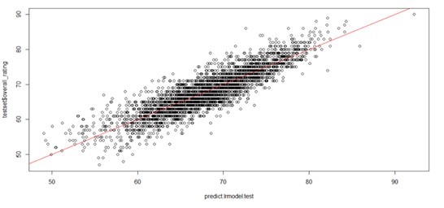
Linear Regression
Namita
Variable importance using T-statistic
Computed using model coefficients
Interpretation: mean change in overall rating given 1 standard deviation shift in x-variable
Most significant variables are
reactions (52.42)
ball control (28.66)
heading accuracy (23.31)
short passing (11.46)
positioning (11.00)
RMSE: 2.98
Significant deviation from the regressed line
Weak goodness-of-fit of linear regression model

Slide 22



Multivariate Adaptive Regression Splines (MARS)
Ying Feng
Non-linear relationships were uncovered during data exploration
MARS algorithm considers multivariate non-linearities and creates a piecewise linear model
Degree = 1 MARS Model
Additive MARS Model with no interaction terms among the variables
Degree = 2 MARS Model
Multiplicative MARS Model that assesses potential interactions between hinge functions

Slide 23
Multivariate Adaptive Regression Splines (MARS)
Ying Feng
Initialize MARS on train set
Grow MARS on train set
Prune MARS from train set
Apply model on test set
Select degree
Add hinge functions in reflected pairs with one pair per step by decreasing order of fit
Remove weakest term at each step
Variable Importance from model
Calculate Room Mean Squared Error (RMSE) as an indicator of accuracy

Slide 24
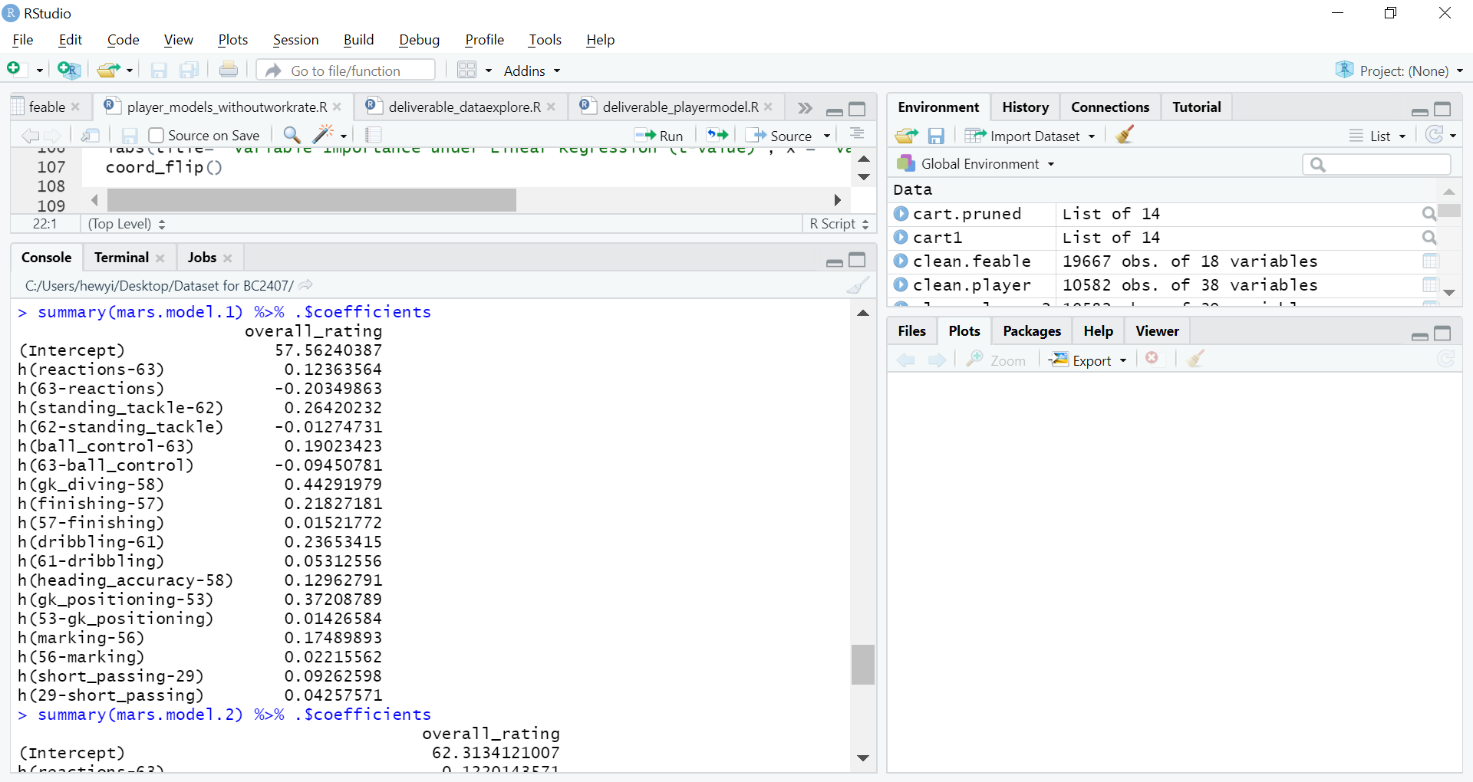
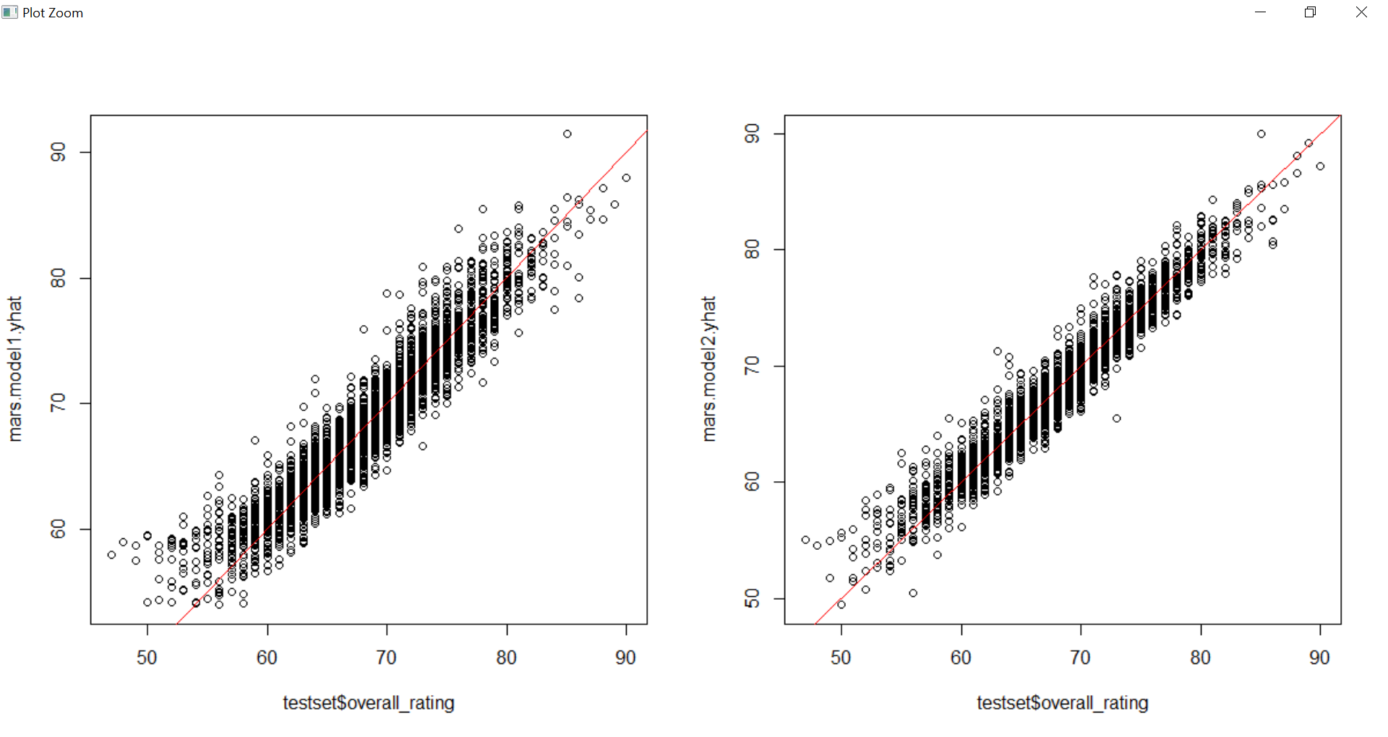
Multivariate Adaptive Regression Splines (MARS)
Degree = 1
Ying Feng
RMSE: 2.08
Lower RMSE and variance of residuals as compared to Linear Regression

Slide 25
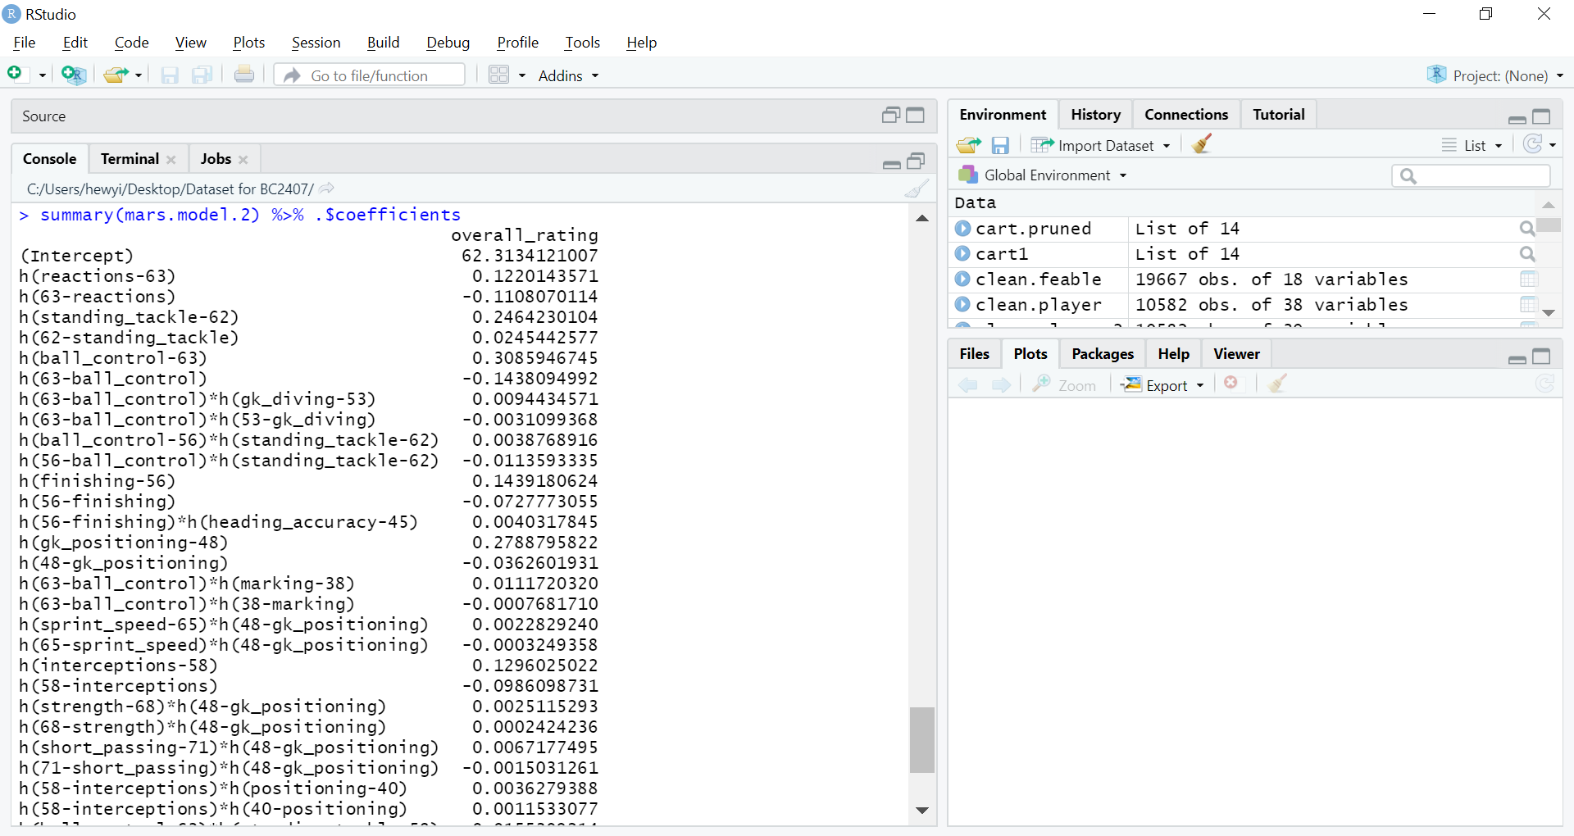

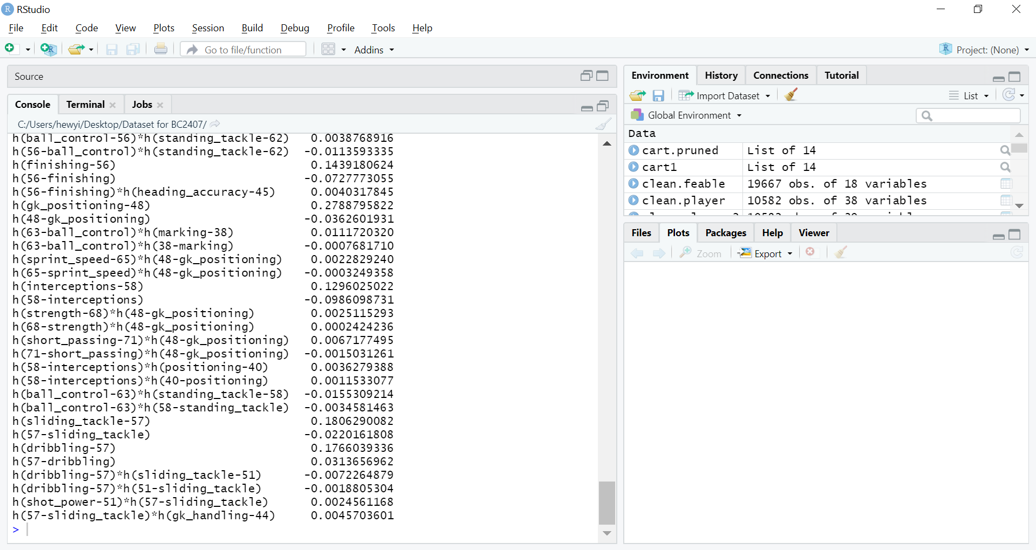
Multivariate Adaptive Regression Splines (MARS)
Degree = 2
Ying Feng
RMSE: 1.54
Improvement in MARS Model performance: Lower RMSE and variance of residuals as compared to MARS Model Degree = 1

Slide 26
Multivariate Adaptive Regression Splines (MARS)
Ying Feng
Degree = 1 | Degree = 2
nsubsets: Variable Importance ranked by the number of subsets that include the variable
1 | Reactions
2 | Standing Tackle
3 | GK Diving
4 | Finishing
5 | Dribbling
1 | Standing Tackle
2 | Reactions
3 | GK Positioning
4 | Ball Control
5 | Finishing

Slide 27
Classification And Regression Tree (CART)
Ying Feng
Grow tree to the maximum on train set
Prune tree on train set
Apply model on test set
Scan all the X-variables and unique values to determine splitting point
Prune away the weakest link in the tree at each cut
Variable Importance from model
Calculate Room Mean Squared Error (RMSE) as an indicator of accuracy

Slide 28
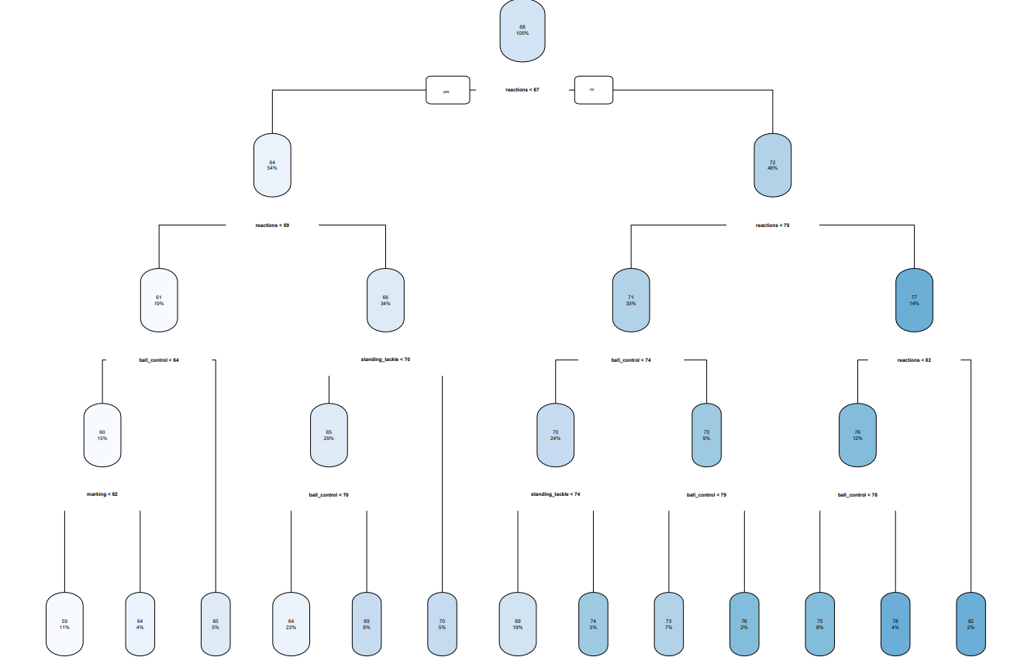
Classification And Regression Tree (CART)
Ying Feng
Steps taken and parameters used to find optimal model:
Growing (Step 1): minsplit = 2, cp = 0
Pruning (Step 2): cp = cp.opt
Variables used in tree construction:
Ball control
Marking
Reactions
Standing tackle
RMSE: 3.36
Highest deviation of predicted values from actual

Slide 29
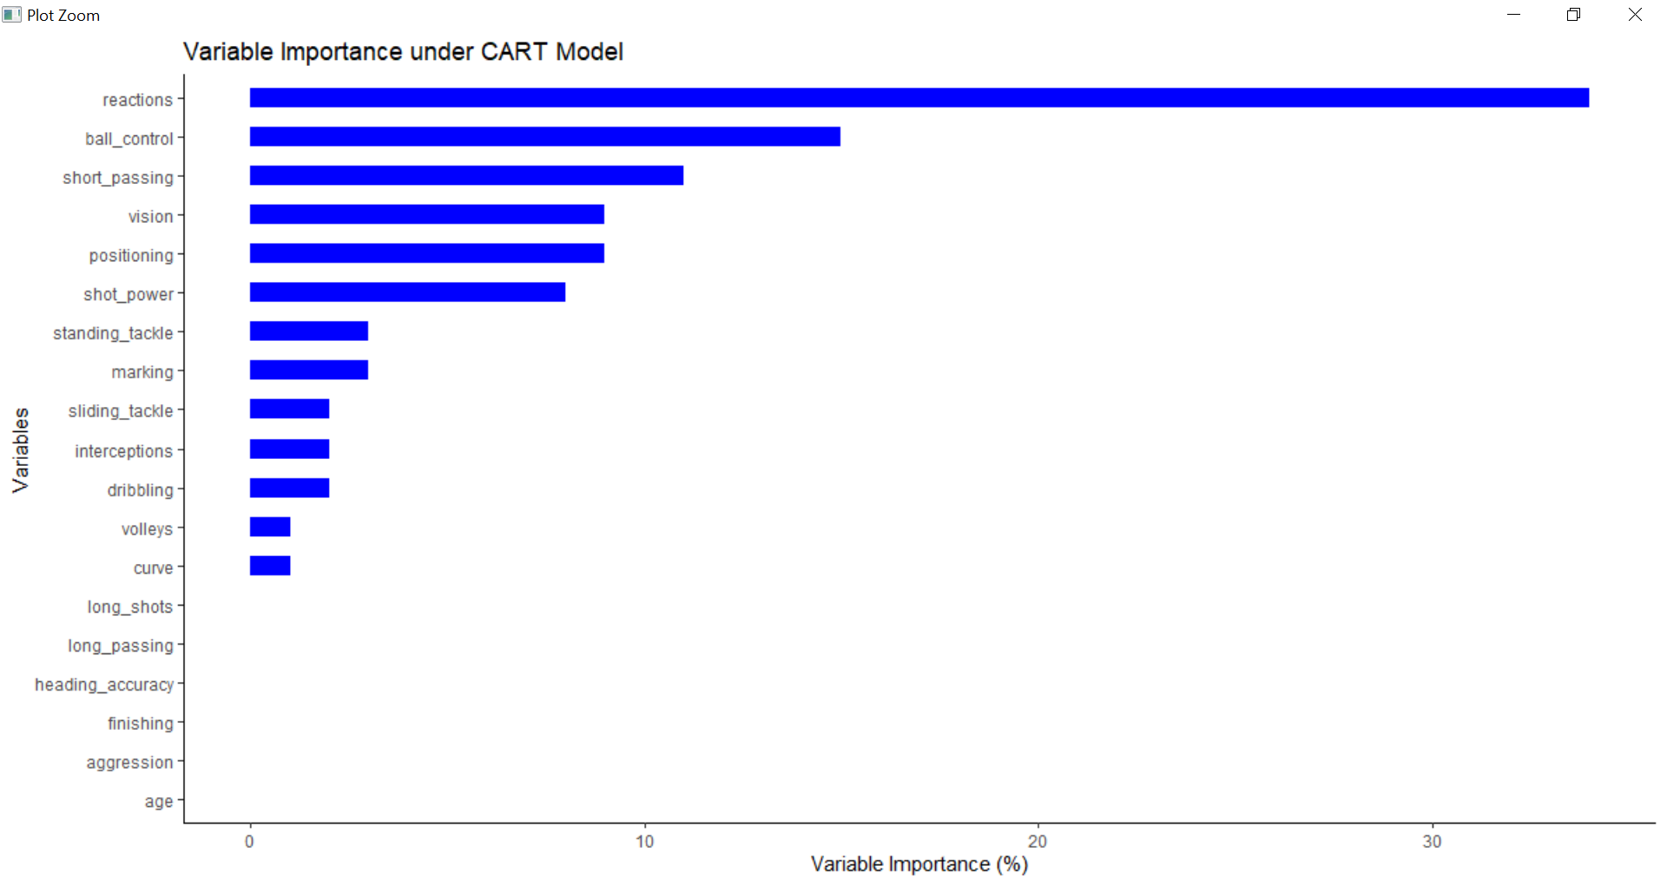
Classification And Regression Tree (CART)
Ying Feng
Deviance/node Sum of Squared Errors from actual value of overall rating

Slide 30



Random Forest
Ying Feng
Create Model from train set
Apply model on test set
Randomly sample data points in each of the tree
Variable Importance from model
Calculate Room Mean Squared Error (RMSE) as an indicator of accuracy
Multiple decision trees and combination of output generated by each decision tree
Decision Tree

Slide 31
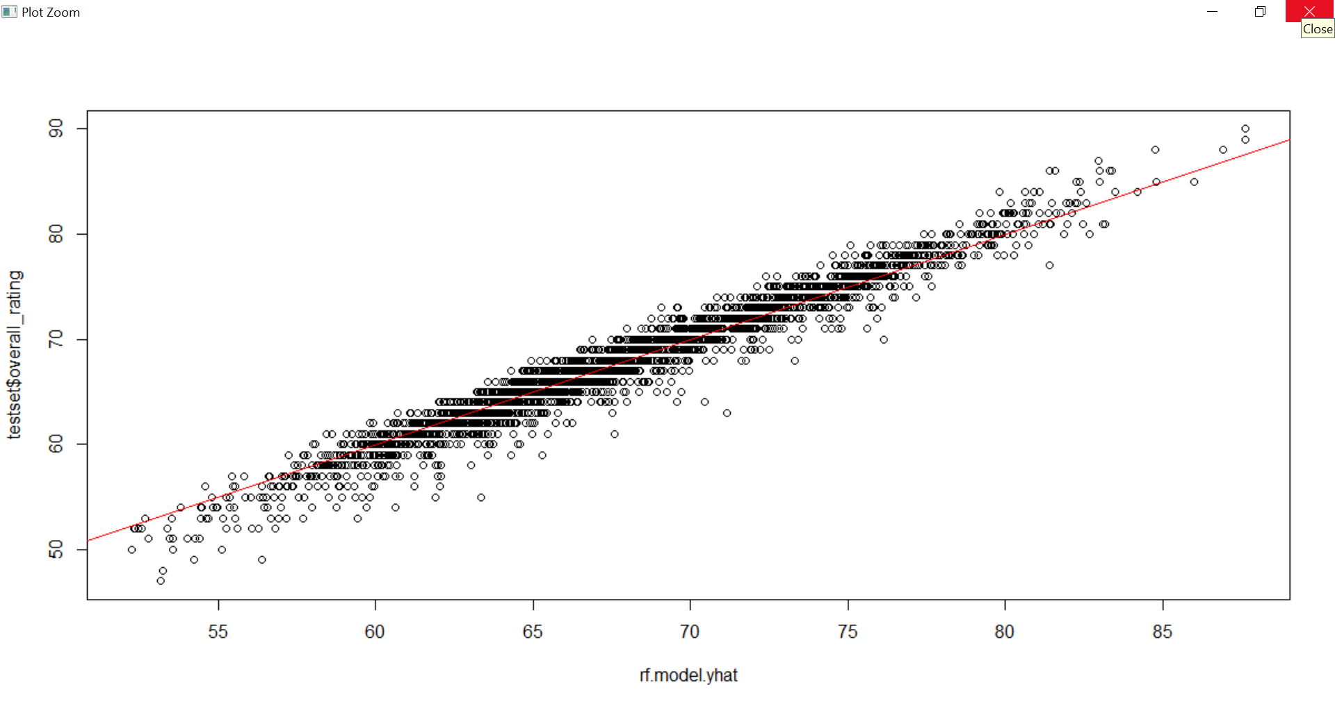
Random Forest
Ying Feng
Model parameters and results :
Number of trees: 500
No. of variables tried at each split (Random Subset Feature size): 12
Out-of-bag Mean Squared Error: 1.868
95.26% variance explained
RMSE: 1.40
Lowest deviation of predicted values from actual values across all models → Most optimal model

Slide 32
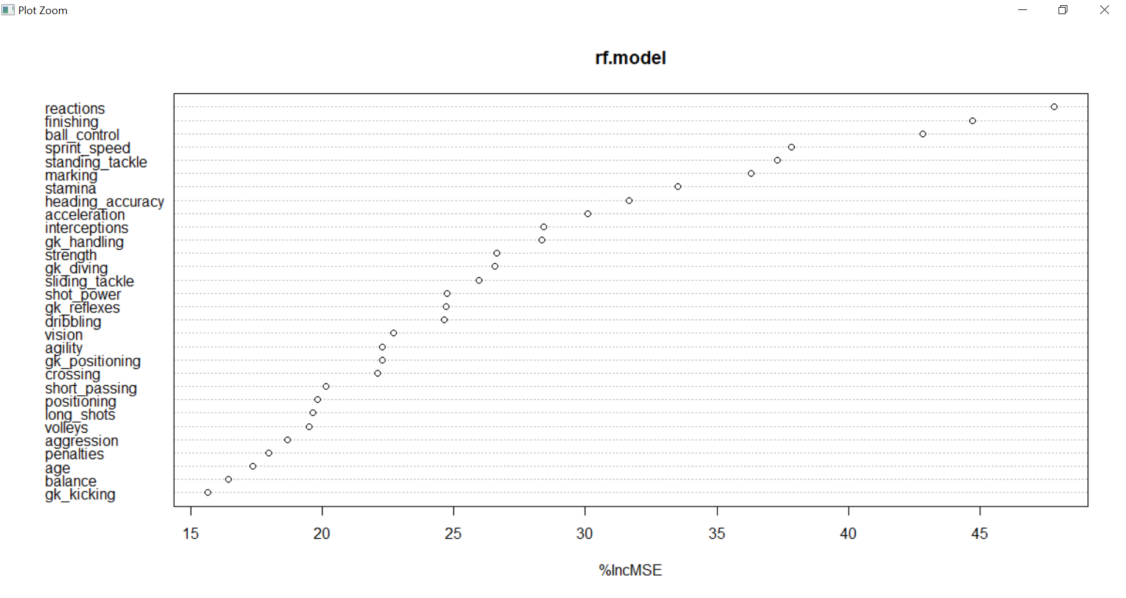
Random Forest
Ying Feng
%IncMSE: Increase in Mean Squared Errors of predicted value as a result of that given variable being randomly permuted

Slide 33

Comparison Across All Models
Random
Forest
MARS
Degree=2
MARS
Degree=1
Linear
Regression
CART
RMSE
Top 5
Important Variables
Random
Forest
MARS
Degree=2
MARS
Degree=1
Linear
Regression
CART
Ying Feng
1.40
1.54
2.08
2.98
3.36
Reactions
Finishing
Ball Control
Sprint Speed
Standing Tackle
Standing tackle
Reactions
GK Positioning
Ball Control
Finishing
Reactions
Standing Tackle
GK Diving
Finishing
Dribbling
Reactions
Ball Control
Heading Accuracy
Short Passing
Positioning
Reactions
Ball Control
Short Passing
Positioning
Vision

Slide 34


Business Implications
Ying Feng
Important variables from model:
Reactions, Finishing, Ball Control, Sprint Speed, Standing Tackle
Additional considerations: Heading Accuracy, Short Passing, Positioning
Recruitment
Training

Slide 35

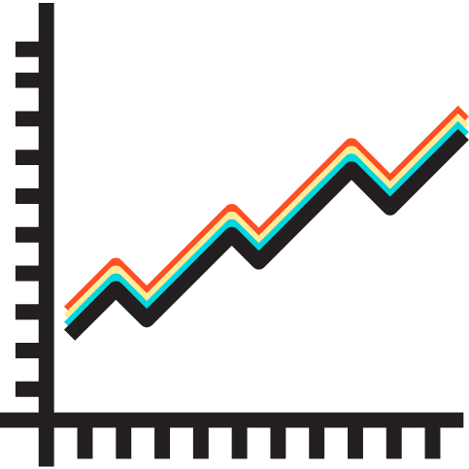
Quantile Regression
Ying Feng
Business Problem: What differentiates a high performing player from an average player, and how significant is this difference?
Quantile Regression
On the top 5 important variables identified by Random Forest model
To gauge the significance of the gap between the top, average and sub-average players
10th, 25th, 50th, 75th, 90th and 99th percentile of players based on overall rating examined

Slide 36
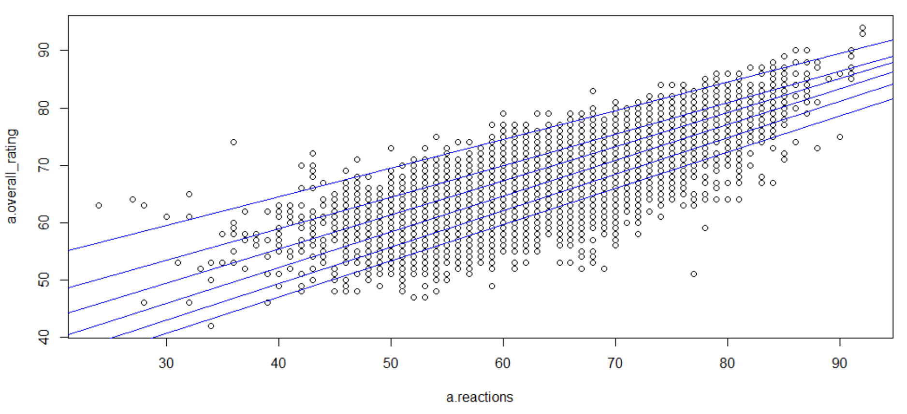
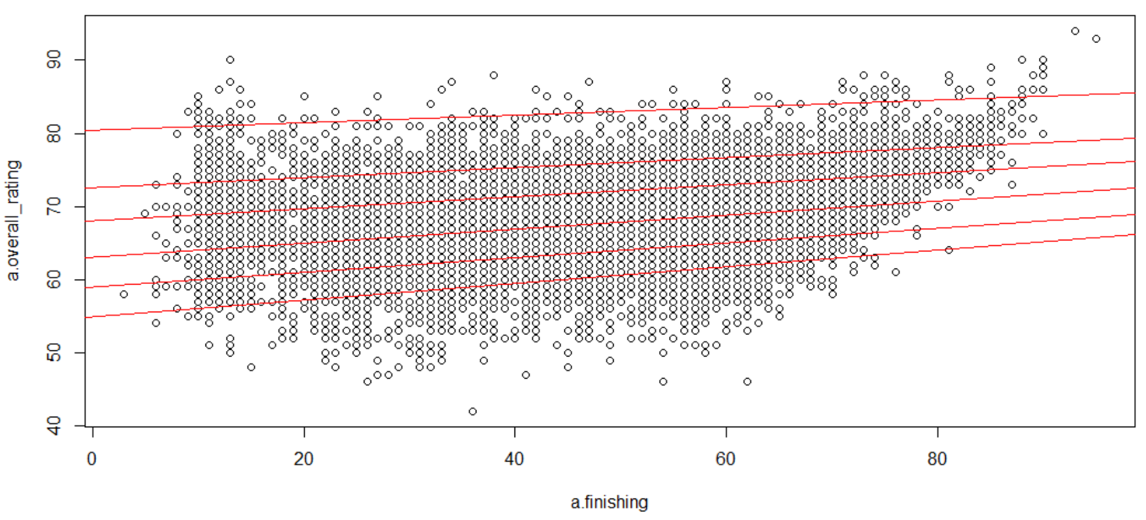
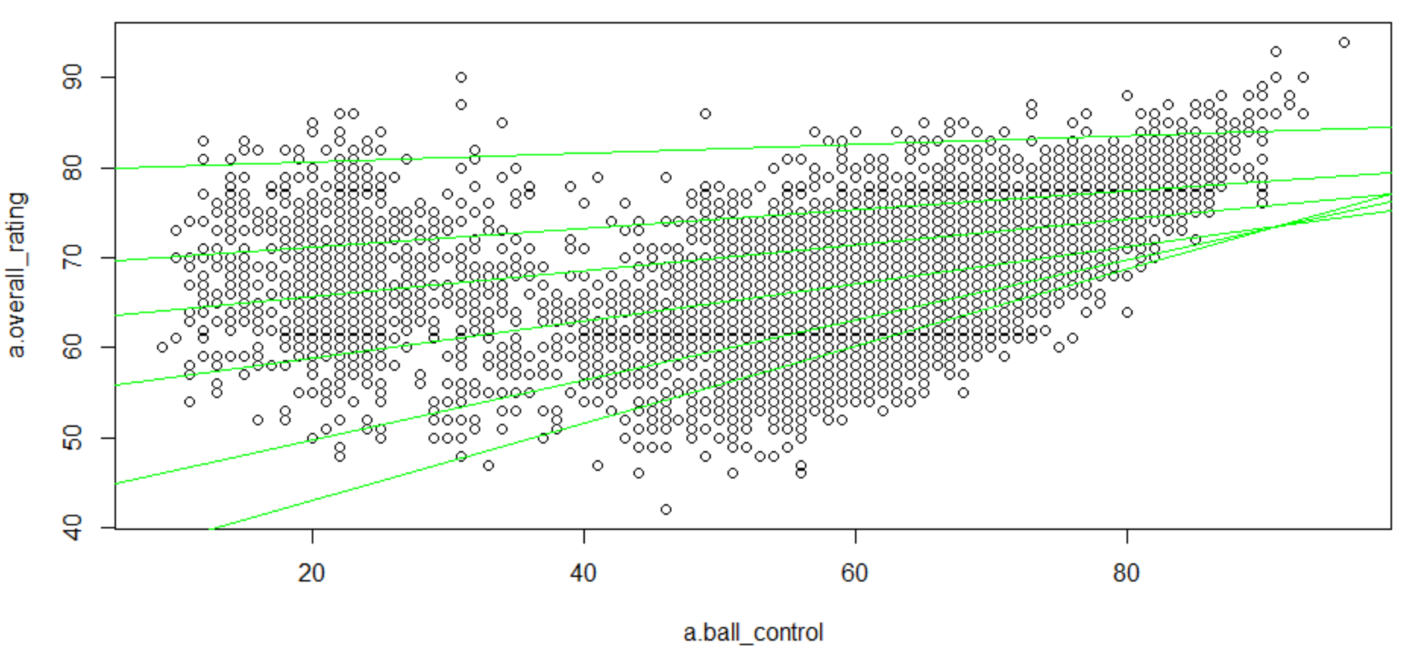
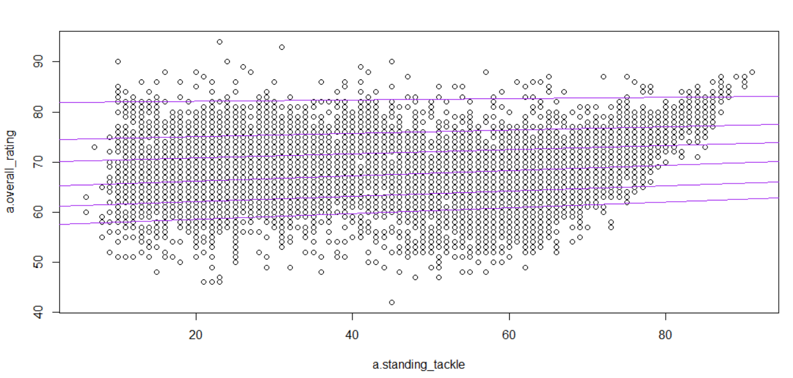
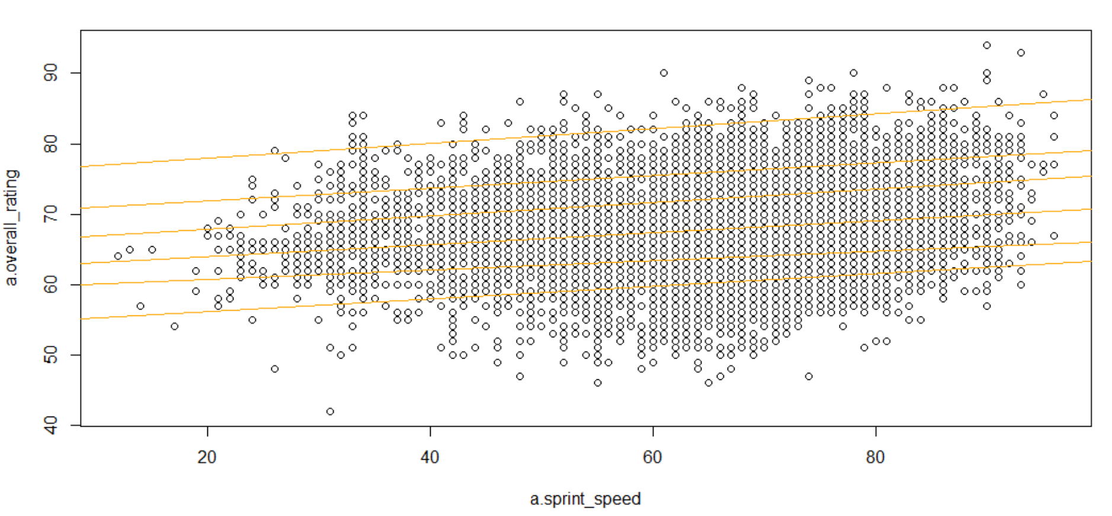
Quantile Regression
Ying Feng
Reactions and Rating
Finishing and Rating
Ball Control and Rating
Standing Tackle and Rating
Sprint Speed and Rating

Slide 37

Quantile Regression
Ying Feng
Significant gap between the 90th and 99th percentile of players
Reactions and Rating
Finishing and Rating
Ball Control and Rating
Standing Tackle and Rating
Sprint Speed and Rating

Slide 38
Quantile Regression
Ying Feng
Reactions and Rating
Convergence of regression lines from lower to higher score of variable:
Attributes like Reactions and Ball Control are hard to master for sub-average to average players
Ball Control and Rating

Slide 39
Quantile Regression
Ying Feng
Divergence and steeper gradient of regression line for the 99th percentile of players:
High performing players tend to work on physical abilities like Sprint Speed to further improve overall rating and differentiate themselves
Sprint Speed and Rating

Slide 40
05
Predictive
Analysis:
Match Outcome

Slide 41

Predictive Models
CLASSIFICATION AND REGRESSION TREE (CART)
RANDOM FOREST
MULTINOMIAL REGRESSION
Jason

Slide 42
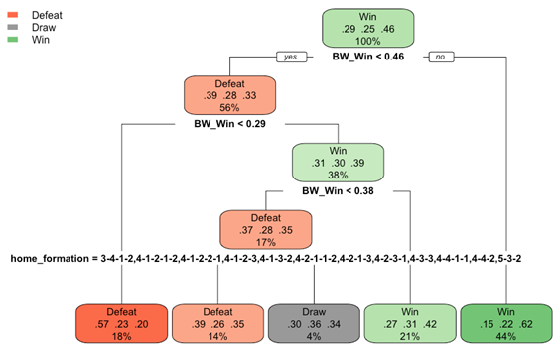
Model Parameters - CART
Jason
Grow Maximal Tree
Prune Using 1 Standard Error Rule
Variable Importance:
BW_Win
Home Team Formation

Slide 43
Model Parameters - Random Forest
Jason
500 Bootstrap Samples
4 Random Subset Features
Out-Of-Bag (OOB) Error = 48.61%

Slide 44
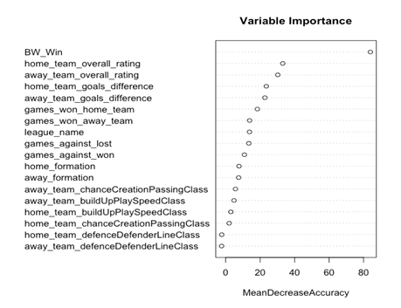
Model Parameters - Random Forest
Jason

Slide 45
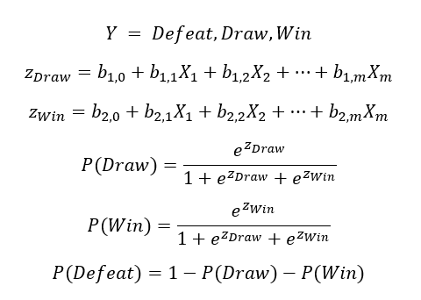
Model Parameters - Multinomial Regression
Jason
2 separate logistic regression models with Defeat as baseline
Predicting Draw/Defeat
Predicting Win/Defeat
Variable Importance can be inferred from the magnitude of coefficients

Slide 46
Variable Importance - Multinomial Regression
Jason
Logistic Model Predicting Draw/Defeat | Logistic Model Predicting Win/Defeat
Home_formation (5-3-1-1) | BW_Win
BW_Win | Home_formation (3-3-3-1)
Home_formation (3-4-3) | Away_formation (3-2-4-1)
Home_formation (5-3-2) | Home_formation (5-3-1-1)
League (Portugal Liga ZON Sagres) | Away_formation (5-3-1-1)

Slide 47
Model Comparison
Random Forest
Multinomial Regression
Model
CART
Accuracy
52.89%
51.18%
52.97%
Jason

Slide 48
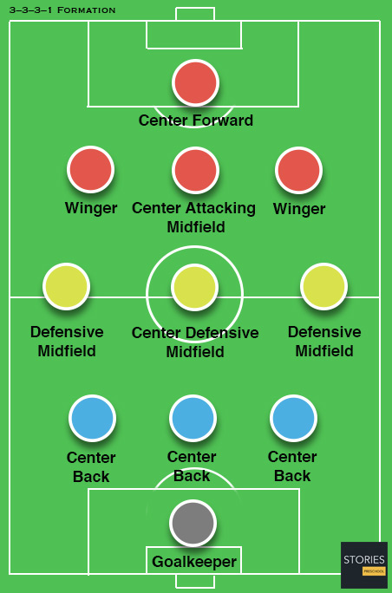
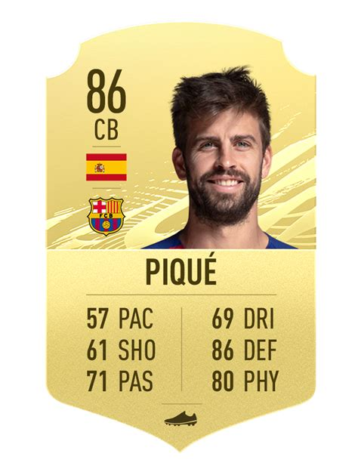
Implications
Team Formations
Player Ratings
Jason

Slide 49
06
Dashboard

Slide 50

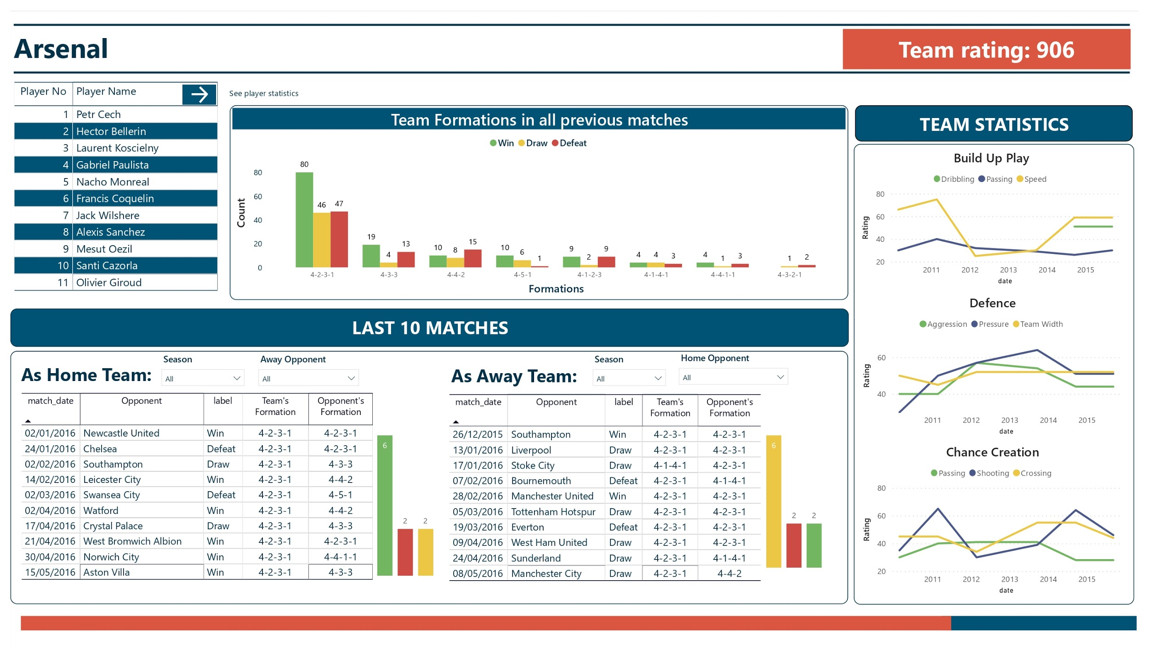
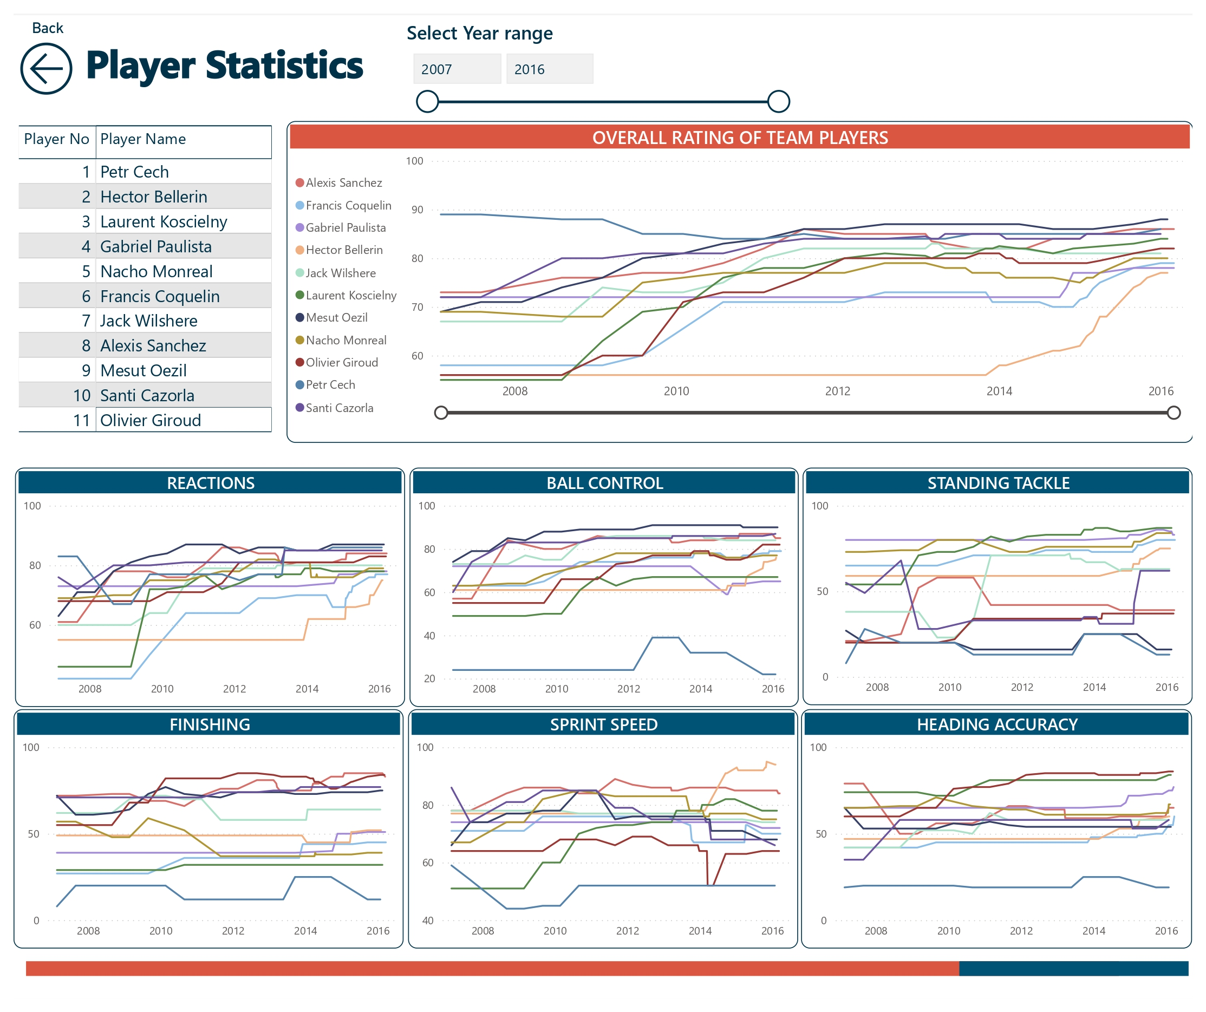
Dashboard overview
Yu Ting
Summarising complex information into friendly user interfaces with interactive features.
Prototype dashboard to track team and players’ performance on Power BI

Slide 51
DASHBOARD LIVE DEMO
Yu Ting

Slide 52
Dashboard Implications
Yu Ting
Understand the influence of formation on the team’s win rates.
Track team’s performance in build up play, defence and chance creation.
Track players’ performance.
Further refine dashboards to incorporate more data
Identify areas of improvement and update training methods.

Slide 53
07
Limitations

Slide 54
Limitations
Yu Ting
Player Rating model
Match Outcome model
Not reflective of real-life player performance.
Concrete data required.
Accuracy is only 52%
Didn’t consider internal factors as information is not public.
Biased towards train set data.

Slide 55
Conclusion
Yu Ting
Player Rating model
Predicting match outcome
Indicators of player performance
Quick visualisation tool
Match Outcome model
Dashboard
Reference point rather than a solution
Soccer analysis more accessible
Formulate team strategies and planning programs

Slide 56
Appendix

Slide 57
Appendix A1: Dashboard Team page

Slide 58
Appendix A2: Dashboard Player page

Slide 59
References

Slide 60
Ganesha, A (2017). “European Football Market to Remain Inflated After Neymar's Record Transfer: Expert”. Retrieved 2 April, 2021, from: https://jakartaglobe.id/news/european-football-market-to-remain-inflated-after-neymars-record-transfer-expert/
Jones, D (2018). “One Year On: How Neymar's Transfer Has Changed Everything”. Retrieved 2 April, 2021, from: https://bleacherreport.com/articles/2789226-one-year-on-how-neymars-transfer-has-changed-everything
Surukumar, Sunil S (2019). “Moneyball or Moneyfall? Current State of Analytics in Soccer and What Future Holds”. Retrieved 2 April, 2021, from: https://lib.dr.iastate.edu/cgi/viewcontent.cgi?article=1224&context=creativecomponents
Cao, Sisi (2018). “Elite Banks Predicted World Cup With AI Models. They Weren’t Even Close”. Retrieved 3 April, 2021, from : https://observer.com/2018/07/goldman-sachs-ubs-predict-world-cup/
Goldman Sachs (2018): “The World Cup and Economics 2018”. Retrieved 3 April, 2021, from: https://www.goldmansachs.com/insights/pages/world-cup-2018/index.html
Smale, S (2020). “Wigan is the latest English football league club to enter administration. It probably won't be the last”. Retrieved 3 April, 2021, from: https://www.abc.net.au/news/2020-07-02/wigan-administration-just-the-start-of-english-football-problems/12414656#:~:text=Wigan%20is%20the%20latest%20English%20football%20league%20club%20to%20enter%20administration.

